Slide 1





Restaurant Recommendation
system
Guided By:
Ms. Trupti Joshi
Mr. Prasad Deshmukh
Aditya Patil - 240343025002
Bhavnesh Sharma - 240343025009
Kaushik Kedari - 240343025021
Shrikant Gaikwad - 240343025046
Shweta Wable - 240343025047

Slide 2
Table Of Content
1. INTRODUCTION
5. DATA PREPROCESSING
2. PROBLEM STATEMENT
6. MODEL
3. DATASET
7. VISUALIZATION
4. SYSTEM ARCHITECTURE
8. CONCLUSION

Slide 3
INTRODUCTION
The significance of personalized restaurant recommendations has risen as a result of a rapid rise in online dining preference searches.
89% of consumers research dining options on mobile devices before visiting a restaurant and 79% use Google for dining decisions, and 48% rely on social media for food and drink recommendations
Need Of Personalized restaurant recommendations.
In this project, we aim to deliver a Restaurant Recommendation
System with Big Data, Machine Learning, and Cloud Integration.
A. Real-time Dining Suggestions
B. Personalized Restaurant Picks
Source :Toast Restaurant Success Report, 2019 , MGH Survey, 2019 MGH Blog, Upserve Restaurant Insider, 2019 Upserve.

Slide 4

PROBLEM STATEMENT
In today’s digital age finding the right restaurant among countless options can be overwhelming and time-consuming.
Traditional search methods often fail to provide personalized results, leading to unsatisfactory dining experiences.
The Restaurant Recommendation System addresses this issue by utilizing Big Data, Machine Learning, and cloud technologies to offer real-time, tailored restaurant suggestions that match users' preferences and needs.
https://upload.wikimedia.org/wikipedia/commons/f/fd/Problem_Solving_Illustration_%28Concept_Image%29.jpg

Slide 5

YELP dataset is a subset of our businesses, reviews, and user data for use in connection with academic research.
The data is available in Json file format.
This dataset contains 1.5M Businesses data, 7M Reviews data, 2M Users data, 1.2M Check-ins data, 1.5M Tips data.
The Data describes attributes as follows :
a. business.json: business id, name,address,city,postal code,state,lat,long
b. review.json: review text, star ratings, and helpfulness votes
c. user.json: information about users, their review count, average ratings.
d. Check-ins.json : timestamps and user counts
e. Tips: Features brief user-generated tips and advice related to businesses
Dataset

Slide 6



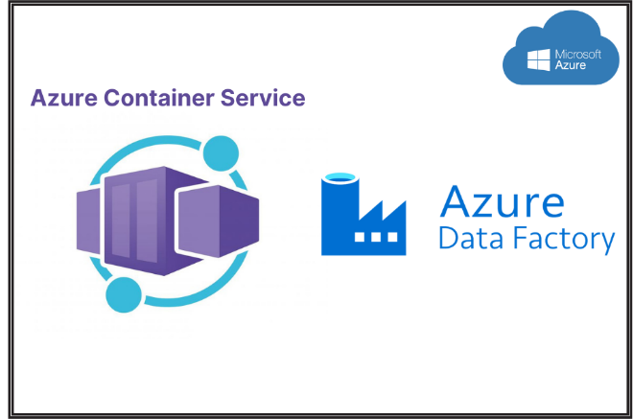


SYSTEM ARCHITECTURE
Data Collection
Recommendation
Model Development
.
Pre-processing
Running Environment

Slide 7
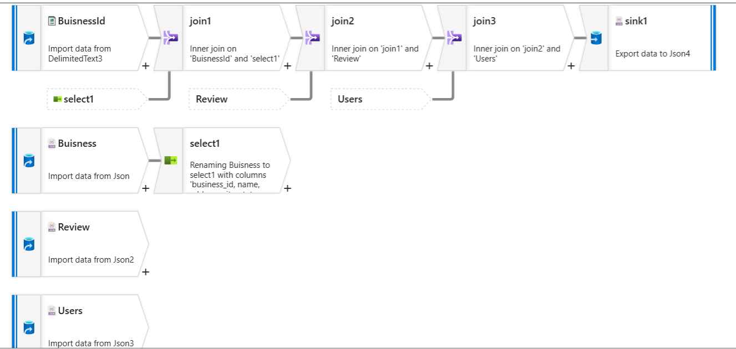
Pre-Processing
Extracting Business ID from Business table
Business ID Table join with Business Table
This 1st join = BusineesID table + Business table
The 2nd join = 1st join + Review Table
The 3rd join = 2nd join + User Table

Slide 8
Pre-Processing
Final table
Alphanumeric ID’s converted to Numeric from Final table.
Random Sampling
Final file converted into Parquet file format

Slide 9
Alternating Least Squares
Collaborative filtering
Decomposes user-item interaction matrix into user and item latent factor matrices.
Alternates between fixing user and item matrices to minimize prediction errors.
Efficiently handles large datasets, ideal for big data applications.
A~ U×V
A original data
U user data
V resturant data

Slide 10
Model Working
Creating Spark Session
Importing Final review table parquet file and Final Business table Parquet file.
Converting Alphanumeric values to Numeric using UDF.
Creating functions
Getting top_n_recommendations
Top Recommendations & Filtering.
Join, Sort, & Display.
Add New User: Creates and appends a new user's data to the ReviewDf_name Parquet file with a confirmation message

Slide 11
Model Working
Collect and Save User Rating: Prompts the user to rate a selected restaurant, retrieves the restaurant name, and saves the rating to the ReviewDf Parquet file.
Update Recommendation Model: Retrains the model with the new rating and confirms that the updated model has been saved.
Load, Train, and Save ALS Model: Reads and maps ratings from the ReviewDf Parquet file, manages the model storage by deleting any existing model, trains a new ALS model, and saves it to the specified path.
Display Top 5 Rated Restaurants: Sorts restaurants by rating in descending order, selects the top 5, and displays their details

Slide 12
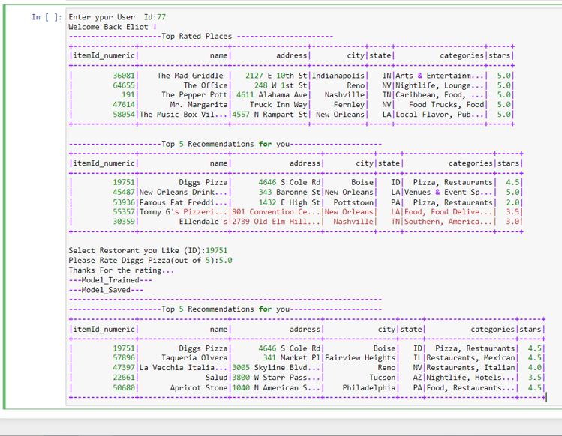
OUTPUT

Slide 13

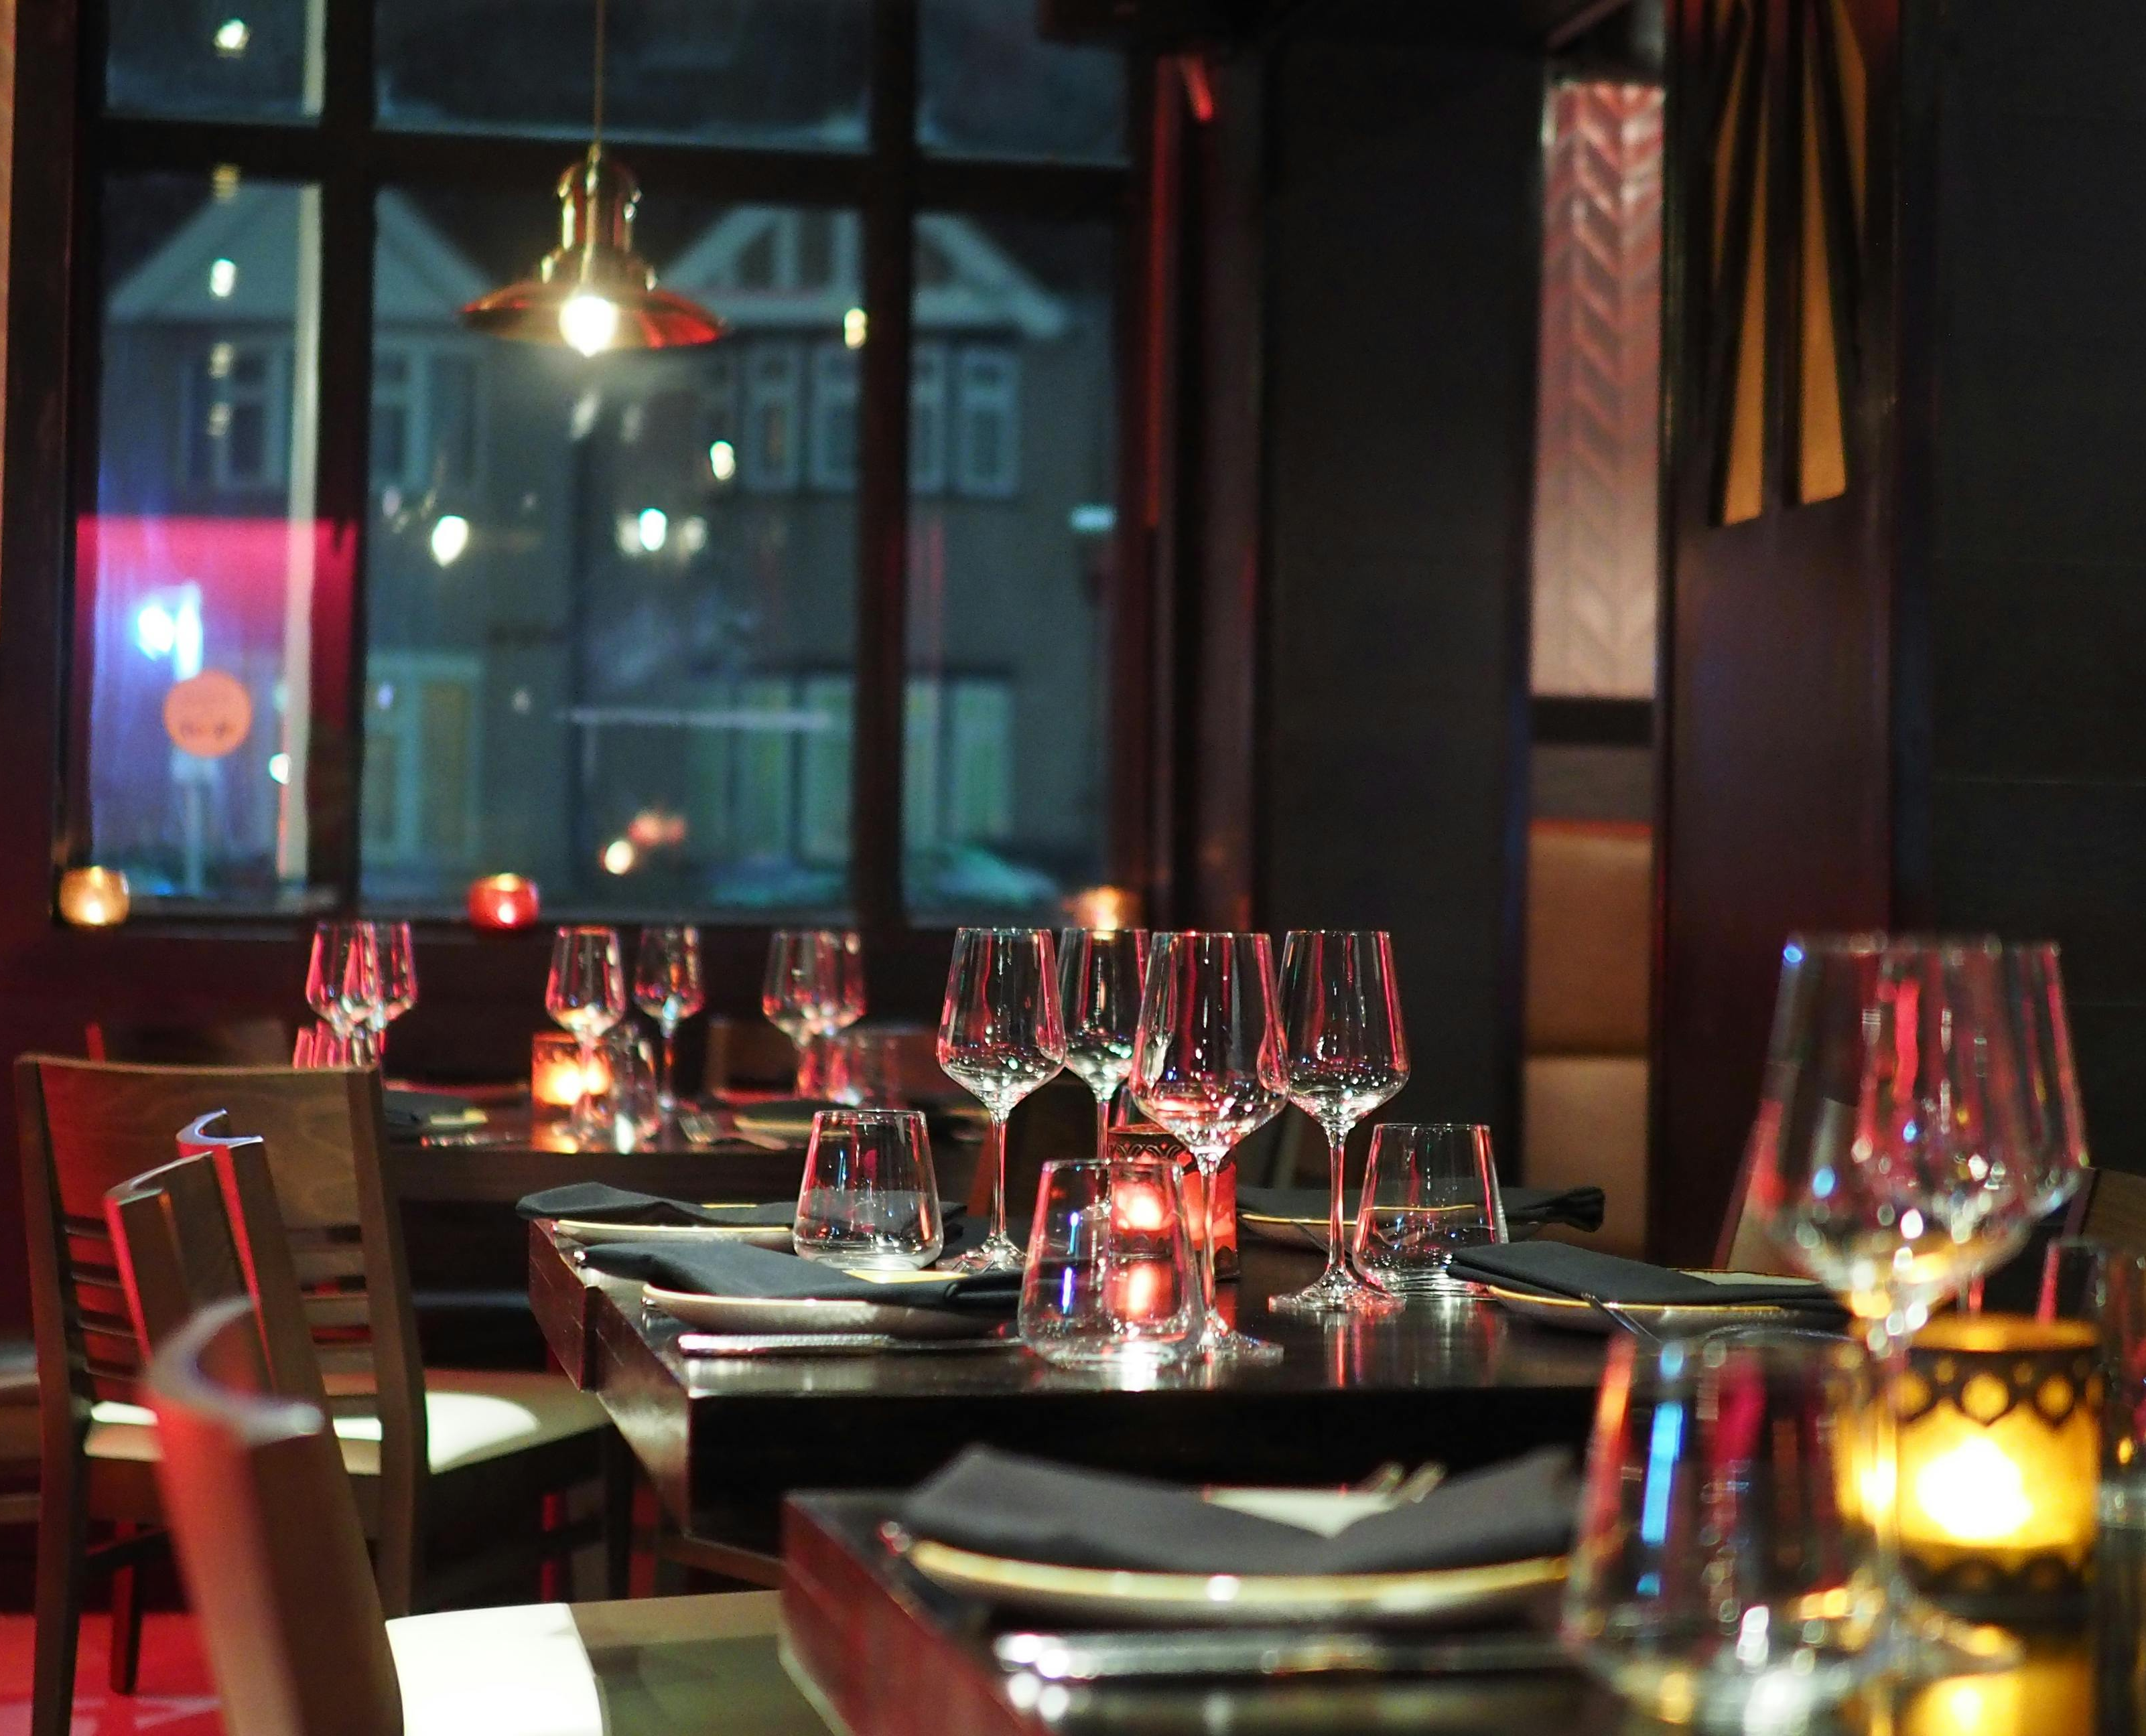
FUTURE SCOPE
Scalable Data Architecture
Enhance the system's scalability to handle larger datasets, potentially integrating more comprehensive data sources such as entire Yelp dataset, social media activity, weather patterns, and event schedules to refine recommendation accuracy
Advanced Predictive Analytics
Use advanced predictive analytics with Big Data technologies like Apache Spark and Hadoop to forecast trends in the restaurant industry, such as emerging cuisines or popular dining times, and incorporate these insights into the recommendation system.

Slide 14
CONCLUSION
Our Restaurant Recommendation System successfully uses Big Data and Machine Learning to provide personalized dining suggestions. By applying the ALS algorithm, we tailored recommendations based on user preferences and location. Tableau was used to visualize trending restaurants, combining review counts with average ratings. This project not only improves user experience but also offers valuable insights for restaurant owners, showcasing the practical application of advanced data technologies in the restaurant industry

Slide 15

THANK YOU

